Slide 1



Yelp Feat. AWS
2022
Search Engine for Customers
Powered by AWS
Group 9
Zhenyu Cheng
Hangyu Li
Juye Xiao
ShuChen Yao
Notes:
Hi everyone. We are in group Nine. Today we are going to introduce a search engine powered by Amazon Web Services based on the reviews on Yelp.com

Slide 2
Presentation Agenda
Business Plan
Responsibility
Success Criteria
1
2
3
4
5
Data Source and Procurement
System Design
2022
Notes:
We are going to go through the Introduction, Data source and procurement, Team responsibilities, system design and success criteria.

Slide 3
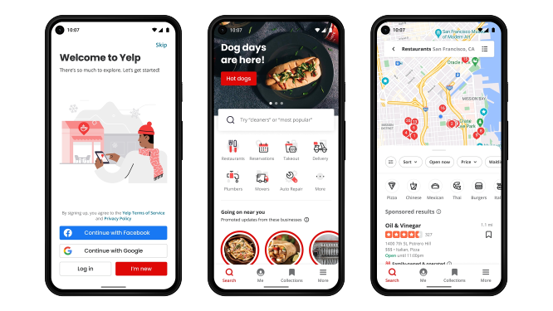
INTRODUCTION
Yelp, a big tech company providing online services, was founded in 2004 in San Francisco.
Crowd-sourced reviews about businesses
Yelp has a massive raw database of reviews, ratings, and other essential information about local businesses that provide users with many options and choices when looking for a particular service.
2022
Notes:
So, yelp, as we all know, is a big tech company founded in 2004 in San Francisco.
It publishes crowd-sourced reviews about local businesses, especially for restaurants, bars, Hair salons, and doctors.
Yelp has a massive raw database of review rating, and other essential information about local businesses that provide users with many options and choices when looking for a particular service.

Slide 4
Business Plan
Simplified version of Yelp that focuses more on meaningful Customer reviews.
To Help customers gain insightful information about local business operations based on feedbacks of other customers.
To create a search engine to retrieve data from cloud database RDS and present on flask with EC2 that allows User to glimpse the top 10 reviews of local business based on the zipcode.
2022
Notes:
Nowadays, yelp has Many meaningless reviews generated by robots. Therefore, we would like to launch a Simplified version of Yelp that focuses more on meaningful Customer reviews.
Our business plan is to help customers gain insightful information about local business operations based on feedback of other customers.
Our mission is to create a search engine to retrieve data from cloud database RDS and present on flask with EC2 that allows User to glimpse the top 10 reviews of local business based on the zip code.
Next I will pass it to my teammate Xiao for the Data Source and Procurement.

Slide 5

Data Source and Procurement
Data Source
External source: yelp.com/dataset
Raw Data Size: 5.1 Gbs
Data Cleaning
Exclude 0s and NAs
Remove Duplicates
Filter Review with ⭐stars>3
Data Integration
Import data into AWS S3 & ETL in RDS
Create a cloud database to extract data from
Create two tables in PostgreSQL
2022

Slide 6
Data Source and Procurement
Data Administration
Build a search engine to retrieve data from cloud database
Quantitative Quality Management
Compare the result from search engine with desired result to ensure the quality of the system
Measure the speed of retrieval
2022

Slide 7




Team Responsibility
Data Engineering: Shuchen Yao
Create relational databases and store data on RDS
Data Processing: Hangyu Li
Clean data from raw data into desired structure, automated data processing with data pipelines in S3 Storage
Cloud Infrastructure: Zhenyu Cheng
Responsible for constructing AWS platform, managing VPC and system deployment
Front end: Juye Xiao
Create frontend to return restaurant information and review information in EC2 with Python flask basing on the user input.
2022

Slide 8

Security Plan
01
02
03
VPC
VPC provides security access for the group members to conduct analysis on different platforms and devices
NAT Gateway
Allows access to application servers and permits proxying of a set of servers on a private subnet.
KMS
Group-owned key pair to limit access to our system and database
2022

Slide 9



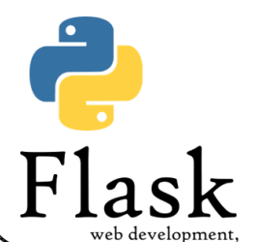
System Design
Raw Dataset
AWS KMS
AWS EC2
AWS S3
AWS RDS
2022
Notes:
Let’s have an overview of our system design, firstly we stored our raw data into AWS S3 adapted AWS EC2 as our cloud virtual machine for various computations, including ETL process to transfer and process data from S3 to RDS, and construct a cloud relational database using AWS RDS, and then deployed our search engine using Flask.

Slide 10
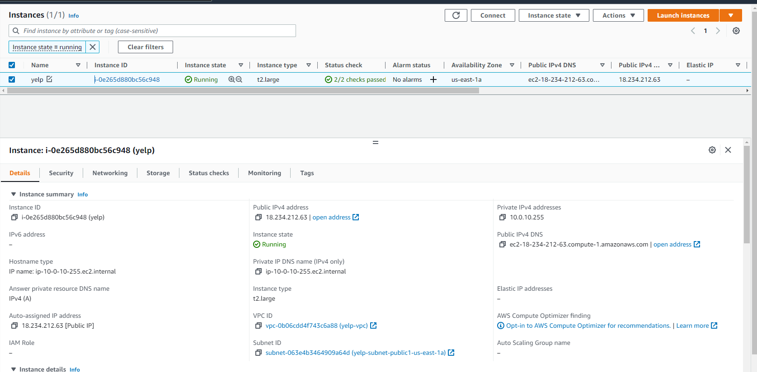
Implementation
Setting up the VPC Setting up key pairs and Launch EC2 Instance
2022
Notes:
For the implementation steps, firstly we construct our own VPC that provide access to only our group members, and attached all those resources, including EC2 and RDS with in the same VPC for our system deployment

Slide 11





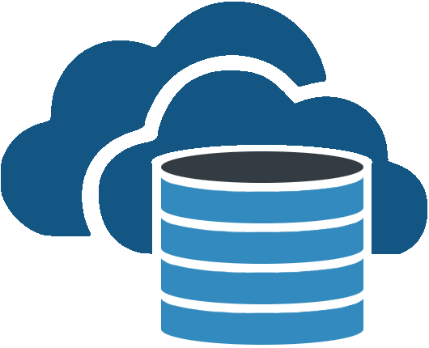
ETL Process
Load clean data into RDS
Extract
Deploy
Load
Yelp data from yelp(JSON files), stored in S3
Front-End Development
(Flask)
Transformation
Data cleaning using python scripts in EC2
Cloud Data Warehouse
(AWS RDS)
Notes:
This is our ETL process overview, we stored our data in S3 and wrote data cleaning python scripts as well as process data into RDS using EC2, after then we deploy our system using flask under a public dns.

Slide 12
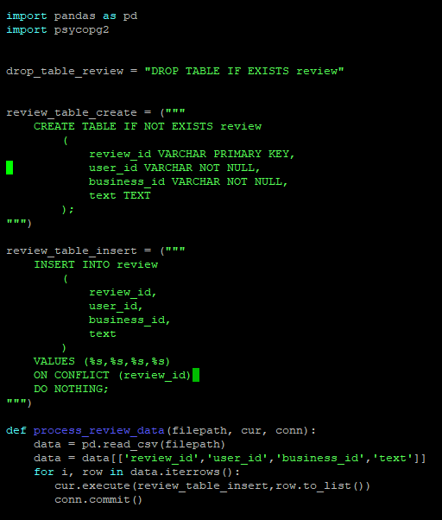
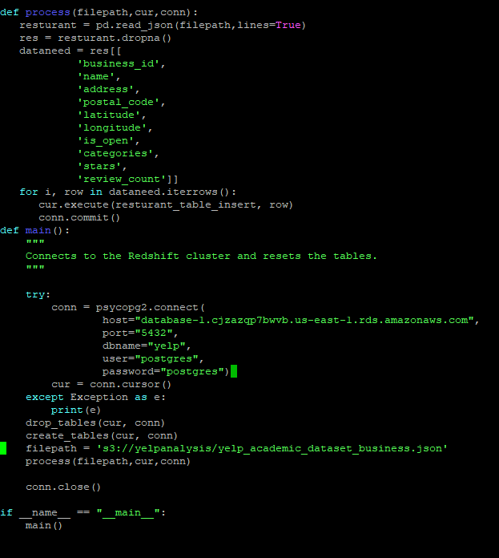
Implementation
Sample Code of ETL process: transferring and processing data from S3 to RDS
2022
Notes:
Next we created our EC2 instance and ran ETL process to transfer our data from S3 to RDS, we used two dataset from yelp and constructed two relational tables in RDS, then we will connect with our flask and interact with flask to deploy our search engine with search criteria like address and category of business, our system will return the top 10 business that fit your search criteria

Slide 13
Implementation
System Demonstration
2022
Notes:
This is a sample output for the search, if we enter a zip code like 93101, and we want to find some chinese cuisine, our system will return the top Chinese restaurants in this address and selected reviews from previous customers. In future, we will deploy our system with a public URL so that everyone can access and use the system. Next my teammate will introduce our cost analysis and success criteria.

Slide 14

Cost Analysis
VPC:
NAT Gateway 33.30 USD/month, DataTransfer 0.90 USD/month
(inbound: 0.00 USD/month
outbound: 0.90 USD/month)
Total Cost:
109.6 USD/month
EC2:
EC2 Instance saving plan 72 USD/month
Key Management Service 1.00 USD/month
S3:
Standard monthly cost of 0.30 USD/month
RDS:
Standard monthly cost of 2.10 USD/month
2022

Slide 15
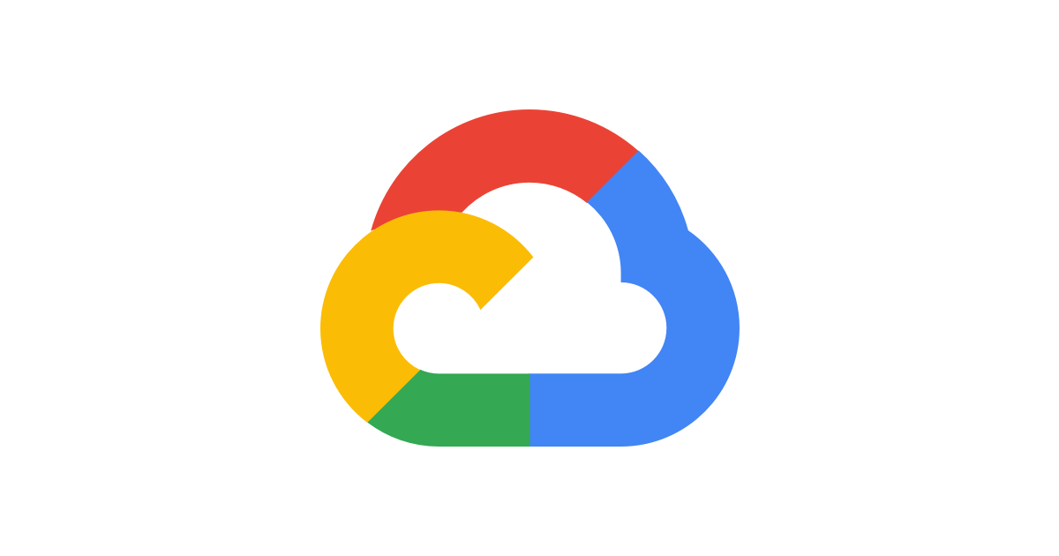
Comparison with Google Cloud
Total Cost:
178.68 USD/month
EC2:
EC2 Instance saving plan 92.72USD/month
Key Management Service 0.00 USD/month
Cloud Storage:
Standard monthly cost of 3.10 USD/month
RDS:
Standard monthly cost of 82.86 USD/month
2022

Slide 16

Success Criteria
Proposed Metrics
Assessment
Quantitative Measures
Retrieval time
Qualitative Measures
Data Quality
Accuracy and Precision
Reliability and Consistency
Validity
Uniqueness
Satisfactory
Quantitative Measures
Retrieval Time: within a minute ✅
Qualitative Measures
Data Quality:
Accuracy: Relevance of restaurant and review search✅
Consistency: ✅ Consistent performance of queries
Validity: ✅ Data range and type, and code validation
Uniqueness: No data duplication or overlaps✅
Satisfactory
2022

Slide 17
THANKS!
Q&A
2022

